Slide 1
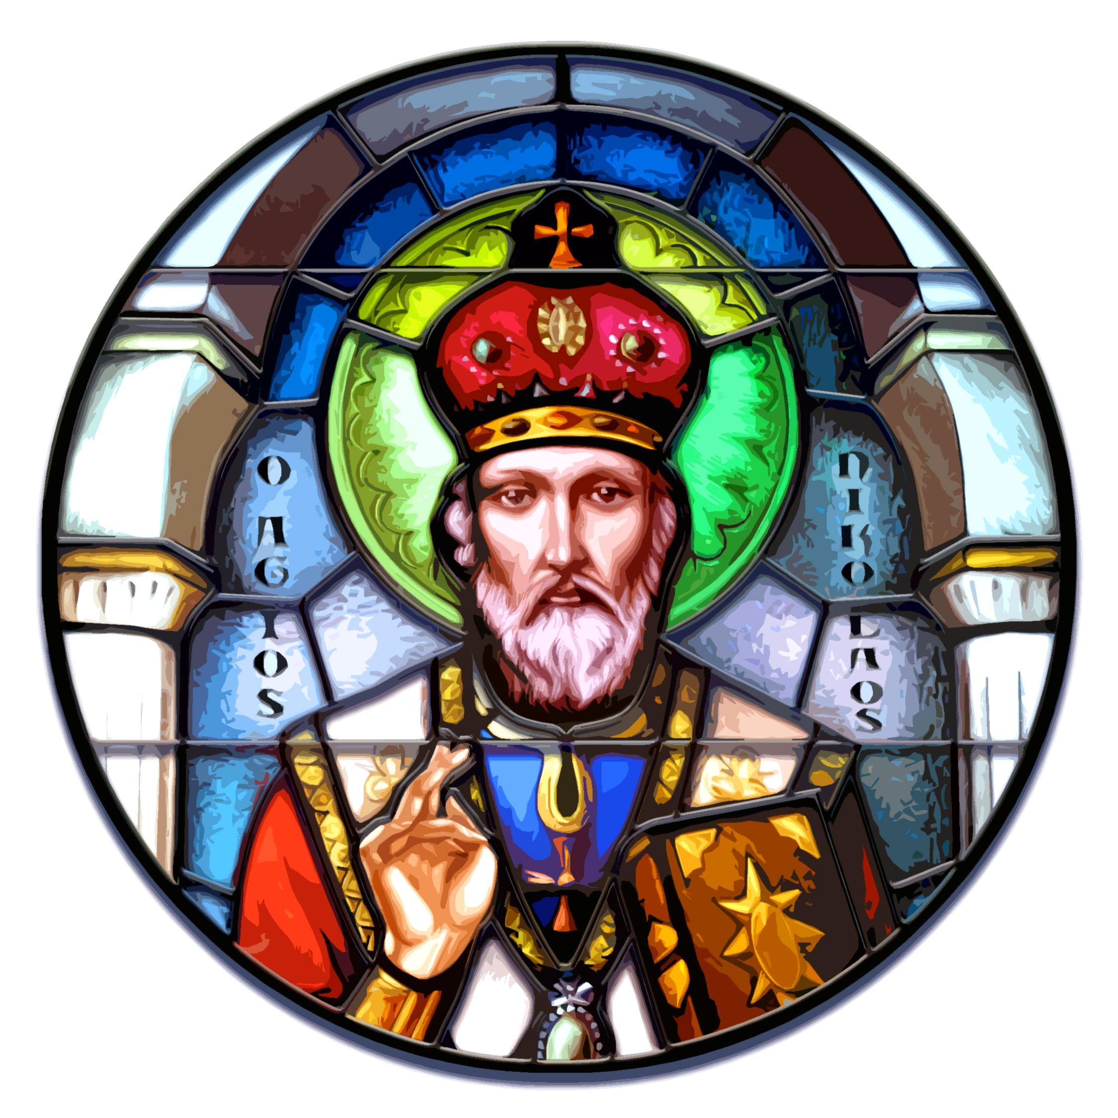
Prison Ministry
St. Nicholas Greek Orthodox Church – St. Louis, MO
"I was naked, and you clothed me; I was sick, and you took care of me;
I was in prison, and you visited me."
Matthew 25:36

Slide 2
Our Mission
The St. Nicholas Prison Ministry believes in the redemptive value of those who are a part of the justice system and seeks to aid the process of assimilation by addressing the essential needs of former offenders and their families, without regard to their past failings and spiritual ideals.​

Slide 3
Our History
The St. Nicholas Prison Ministry began in 2010 by Clark Porter, a parishioner with the goal of assisting former offenders reentering the community who have limited support or resources. The Ministry grew in scope and saw a need to serve the families as well as the former offenders, because families were impacted as well by the former offender’s incarceration. We now direct our services and support to the needs of the former offenders and their families.
We started small by establishing the needs of those released and raised money to fulfill these needs by:
Providing food for families.
Providing bus fair passes for rides to job interviews.
Holding clothing drives to provide decent clothes for an interview.
Providing toiletry/hygiene bag products; many released prisoners that go to a halfway house are lacking these items.
In subsequent years, a toy drive was added, with most gifts in the $20-$30 range. Parishioners can pick up a card with the child’s name/age/want in the gym during Sunday coffee hour or they can donate cash and the committee will purchase the gift. We also established a link to Amazon to allow for online purchases.

Slide 4
Our Successes
To date, St. Nicholas has:​
Chartered eight all-expenses paid trips to federal prisons for families to visit their incarcerated loved ones.
Hosted a Mother-Daughter overnight visit in the Greenville prison for women.
For 14 years annually collected an average of 400 toys for children of former offenders.
Provided the following:
Turkeys and sides to families for the Christmas holiday.
Birth certificates, state identifications, and bus passes to former offenders to assist them in seeking employment.
Shoes and clothing to newly released, as well as furniture, televisions, and appliances to furnish apartments.
Diapers and infant items to new mothers and fathers.
Medical equipment to former offenders who were disabled and not able to get Medicaid approval for the devices.
New winter coats for former offenders and their children.
New laptops and dorm supplies to college freshmen (children of former offenders) and supported a student to study abroad.
Donated two cars to former offenders and their families.
Stocked Federal Probation Office’s food pantry with meat and canned goods.
Donated over $3,000 to support the Orthodox Christian Prison Ministry.

Slide 5
Our Long-Term Goals
Expand the prison trips to other facilities, particularly women’s prisons.
Annually support college-bound freshmen.
Expand relationships with other Orthodox parishes.
Provide for prescription medications and tooth extractions.
Include children of incarcerated.
Getting Your Parish Involved
Start small. Your congregation may need to be sold on the direction.
Contact your state or federal prison and ask if there is someone who handles reentry services for those who are released into the community.
Ask for a meeting with the federal probation chief and state what you can do for those who are released into the community.
Have a plan. When meeting with the federal probation chief, let them know what you would be willing to provide. We suggest volunteering to help acquire birth certificates for 25 clients.
Refer to the pamphlet provided by St. Nicholas Prison Ministry for additional ways to begin.

Slide 6
Our Members
Clark Porter
Theodora (Teddy) Hart
Mary Angelides
Jim Hart
Alexandra Kavourinos
Sue Lampros
For More Information​
For more information on the St. Nicholas Prison Ministry program
Contact Teddy Hart (Thart0126@gmail.com) or Clark Porter (Clark.porter@moep.uscourts.gov).
Go to https://www.sngoc.org/prison-ministry and complete the form requesting additional information.

