Slide 1
St Nectarios Stewardship

Slide 2
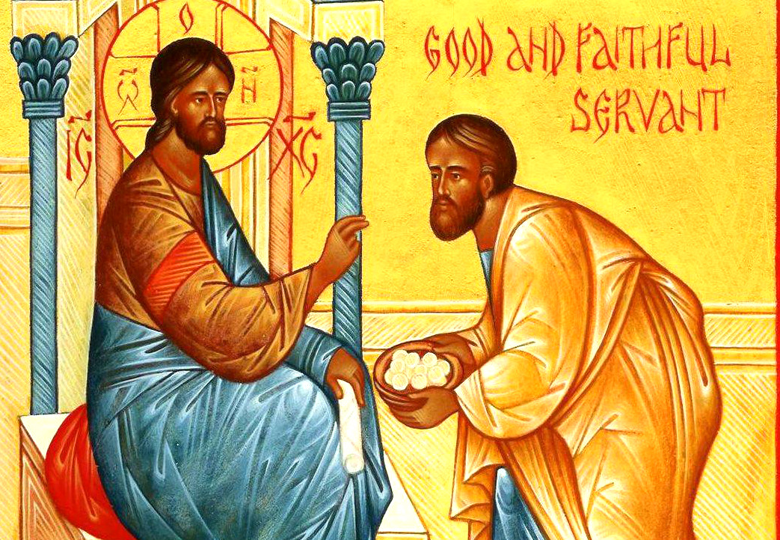
Big Picture Goal
Generosity
100% stewardship funded operational expenses
Faith based Stewardship
Giving because we are called to give out of love and from our abundance

Slide 3
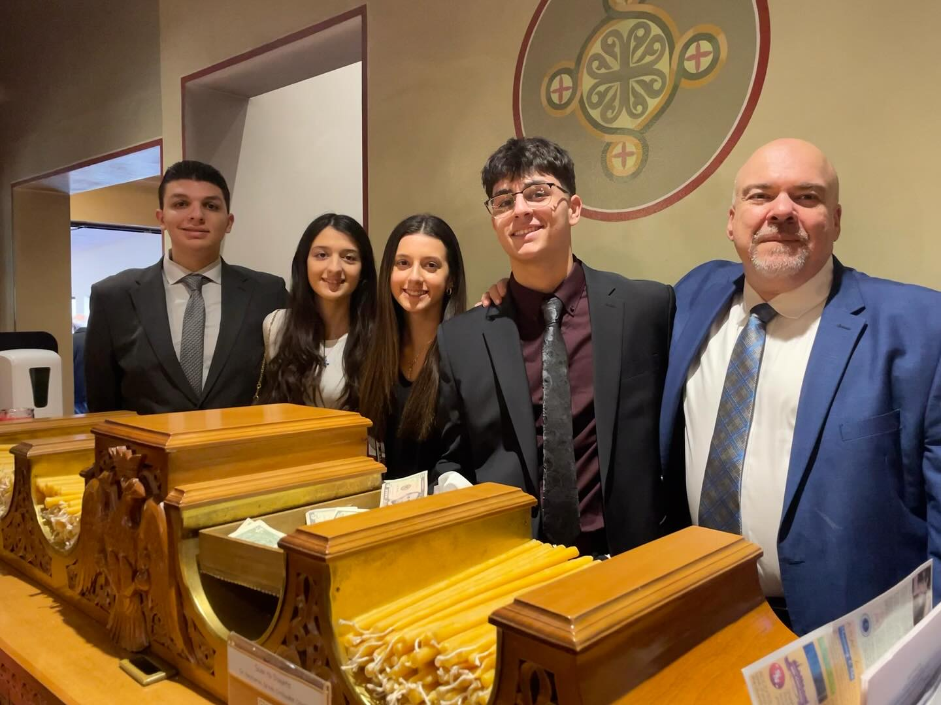
Why do people give…or not give?
Trust in the parish council, priest and administrators
The money is being used appropriately
The vision for the community is inspiring
There is a clear path for the future
They feel appreciated for their efforts

Slide 4
Our Roadmap
Sponsor a day
Volunteer appreciation hosted by the parish council
Stewardship funded sunday school, Youth Ministries, Athletics
Donating a portion of greekfest proceeds
Emphasizing the time and talent aspect - AND TRULY MEANING IT
Thank and acknowledge
Volunteerism
Community Outreach
Time and Talents
Treasure
Notes:
2018 rolled out sponsor a day of operations - meaning, great
Saw large stewardship increases, but ran into timing problems
Lacked the community vision (imagine the possibilies)
Shifted focus to acknowledging and thanking
Began a 2 year process of greating a long range plan along with a vision and mission for our community to rally around
Donated greekfest proceeds when no money

Slide 5
Things that have worked for us - Keys to success
Having the church be an exemplary steward, and promoting it
Getting the maximum people involved in committees, ministries, and work
Expanding the definition of stewardship
Having an innovative and progressive parish council
Social media and communication - Embracing Technology
Being accountable and transparent with everything going on
Redefining how we give

Slide 6
Things we are still working on…
Recurring giving vs pledge and pay
Percentage of income giving (modeling a more protestant approach)
Commuting stewardship to specific groups
Asking for increases
Preaching about true Christian stewardship

